Slide 1


K. RAMAKRISHNAN COLLEGE OF ENGINEERING
(AUTONOMOUS), SAMAYAPURAM – TRICHY
DEPARTMENT OF CSE(ARTIFICIAL INTELLIGENCE AND MACHINE LEARNING)
CGB1221 – DATABASE MANAGEMENT SYSTEMS
BOOK CLUB MANAGEMENT SYSTEM
PRESENTED BY SUPERVISOR
MADHUMITA SP Mr. P.Nagaraj, M.E.,
8115U24AM033 Assistant Professor / AI&ML.

Slide 2
PRESENTATION OVERVIEW
Objective
Project Analysis
System Architecture
Methodology
Entities Used
Modules
Implementation
Conclusion
Future Scope

Slide 3
OBJECTIVE
The main objective of the Book Club Management System is to efficiently manage book club activities such as member registration, book cataloging, borrowing and returning books, and tracking reading activities.
It aims to reduce manual work and provide a user-friendly digital platform for book club operations.

Slide 4
PROJECT ANALYSIS
The system is designed to solve problems in traditional book club management:
Existing Issues:
Manual record keeping (registers/papers)
Difficulty in tracking borrowed books
No centralized database
High chances of data loss and errors
Proposed Solution:
A centralized DBMS-based system
Easy book tracking and member management
Automated records for issue/return
Quick data retrieval and reporting

Slide 5
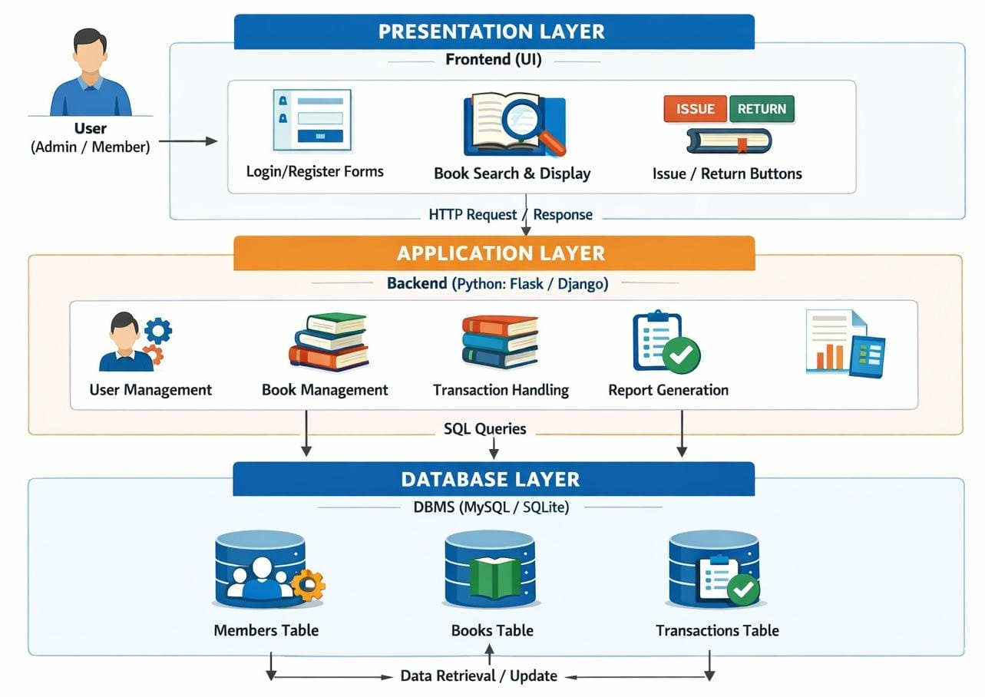
SYSTEM ARCHITECTURE

Slide 6
METHODOLOGY
The system follows a structured development approach:
Requirement Gathering
Identify user needs (admin & members)
System Design
Create ER diagram and database schema
Development
Frontend + Backend coding
Database Creation
Tables for books, members, transactions
Testing
Check for bugs and errors
Deployment
Run system locally or on server.

Slide 7
ENTITIES USED
The system uses structured relational data stored in a database.
Tables:
Members Table
Member_ID (Primary Key)
Name
Email
Phone
Books Table
Book_ID (Primary Key)
Title
Author
Genre
Availability

Slide 8
ENTITIES USED
Transactions Table
Transaction_ID (Primary Key)
Member_ID (Foreign Key)
Book_ID (Foreign Key)
Issue_Date
Return_Date

Slide 9
MODULES
User Management Module
Register/login members
Book Management Module
Add, update, delete books
Search Module
Search books by title/author
Transaction Module
Issue and return books
Admin Module
Manage users and books
Report Module
View issued/returned books

Slide 10
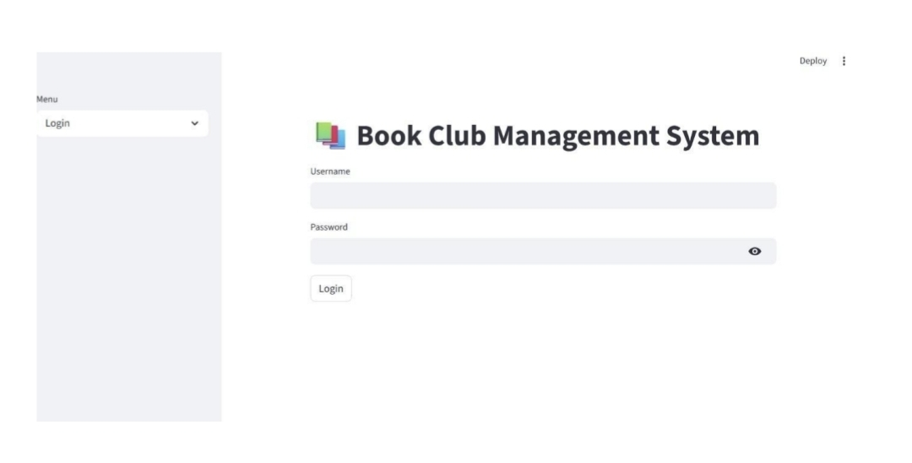
IMPLEMENTATION

Slide 11

IMPLEMENTATION

Slide 12
CONCLUSION
The Book Club Management System successfully automates book club operations.
It improves efficiency, reduces manual errors, and provides a structured way to manage books and members.

Slide 13
FUTURE SCOPE
Mobile application integration .
Barcode/QR code for books .
Online book reservation system .
Email/SMS notifications for due dates .
Integration with e-book platforms .
AI-based book recommendations .

Slide 14


